Slide 1

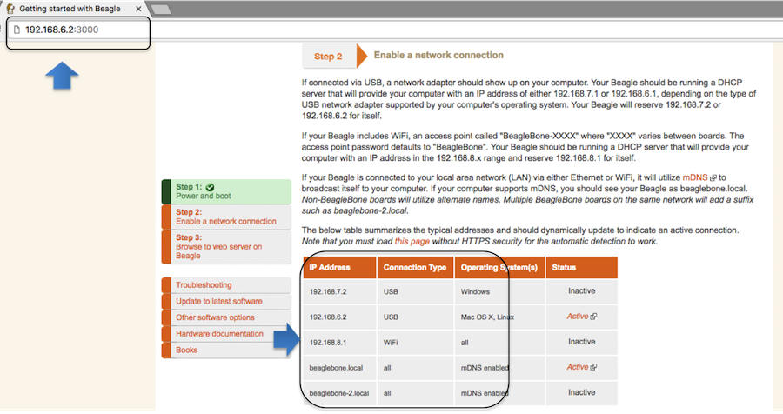
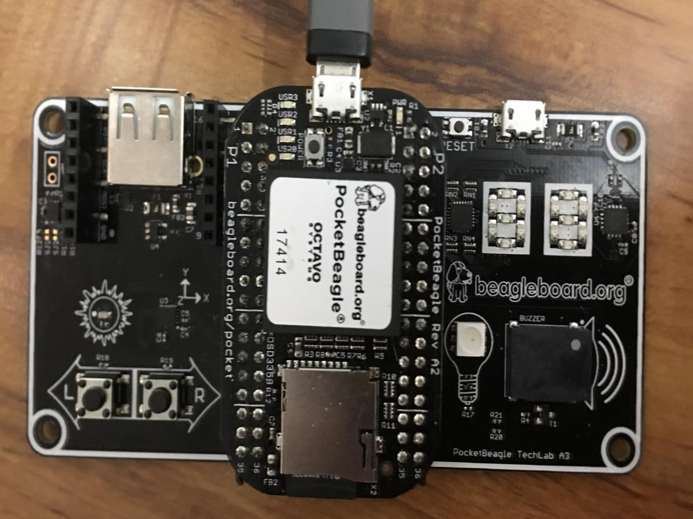
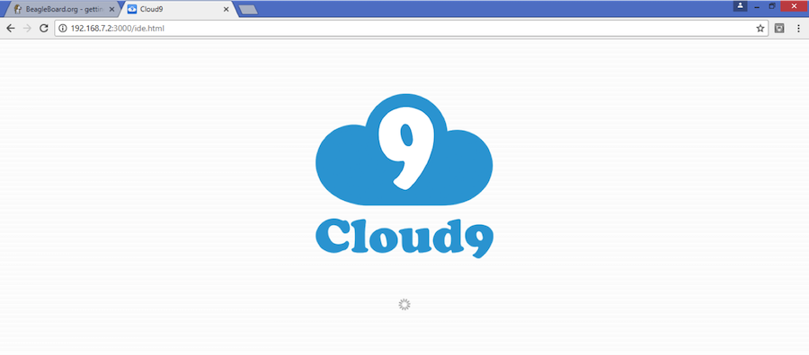
PocketBeagle® TechLab Cape Hands-On Coding Workshop
MicroSD software image and other materials available from bbb.io/techlab
See bbb.io/start for instructions on using Etcher.io to write a microSD card
Plug into the microUSB on PocketBeagle to provide power and a network connection. Look for the “heartbeat” pulse on the USR0 LED to know the board has Linux up-and-running.
Get to the Cloud9 IDE
Served on port 3000
Windows: http://192.168.7.2:3000
Linux/Mac: http://192.168.6.2:3000
The BeagleBoard.org Foundation is a 501(c)(3) non-profit corporation existing to provide education in and collaboration around the design and use of open-source software and hardware in embedded computing.

Slide 2
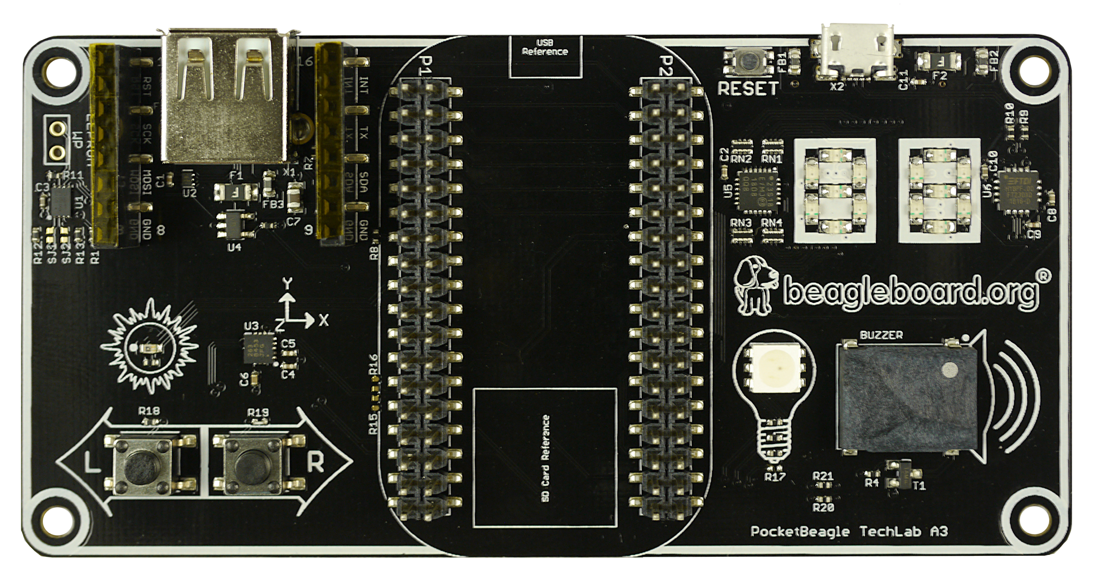
PocketBeagle® TechLab Cape Hands-On Coding Workshop
TechLab Pocket Cape
USB Host A with power
Reset Button
USB-to-Serial Micro B
mikroBus Header www.mikroe.com/click
SPI 2-Digit 7-Segment Displays
ADC Light Sensor
I2C Accelerometer
Buzzer
2 GPIO Push Buttons
PWM Controlled Tri-Color LED
TechLab Wiring Summary
SPI1 CS1
leds/techlab::seg*
0
1
13
8
9
5
6
12
14
10
4
3
2
11
P1_19
iio:device0
I2C2 iio:device1
P2_30
R: P1_33
G: P2_1
B: P1_36
P2_33
P1_29

Slide 3
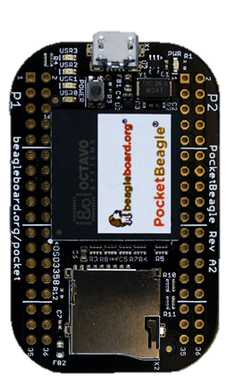
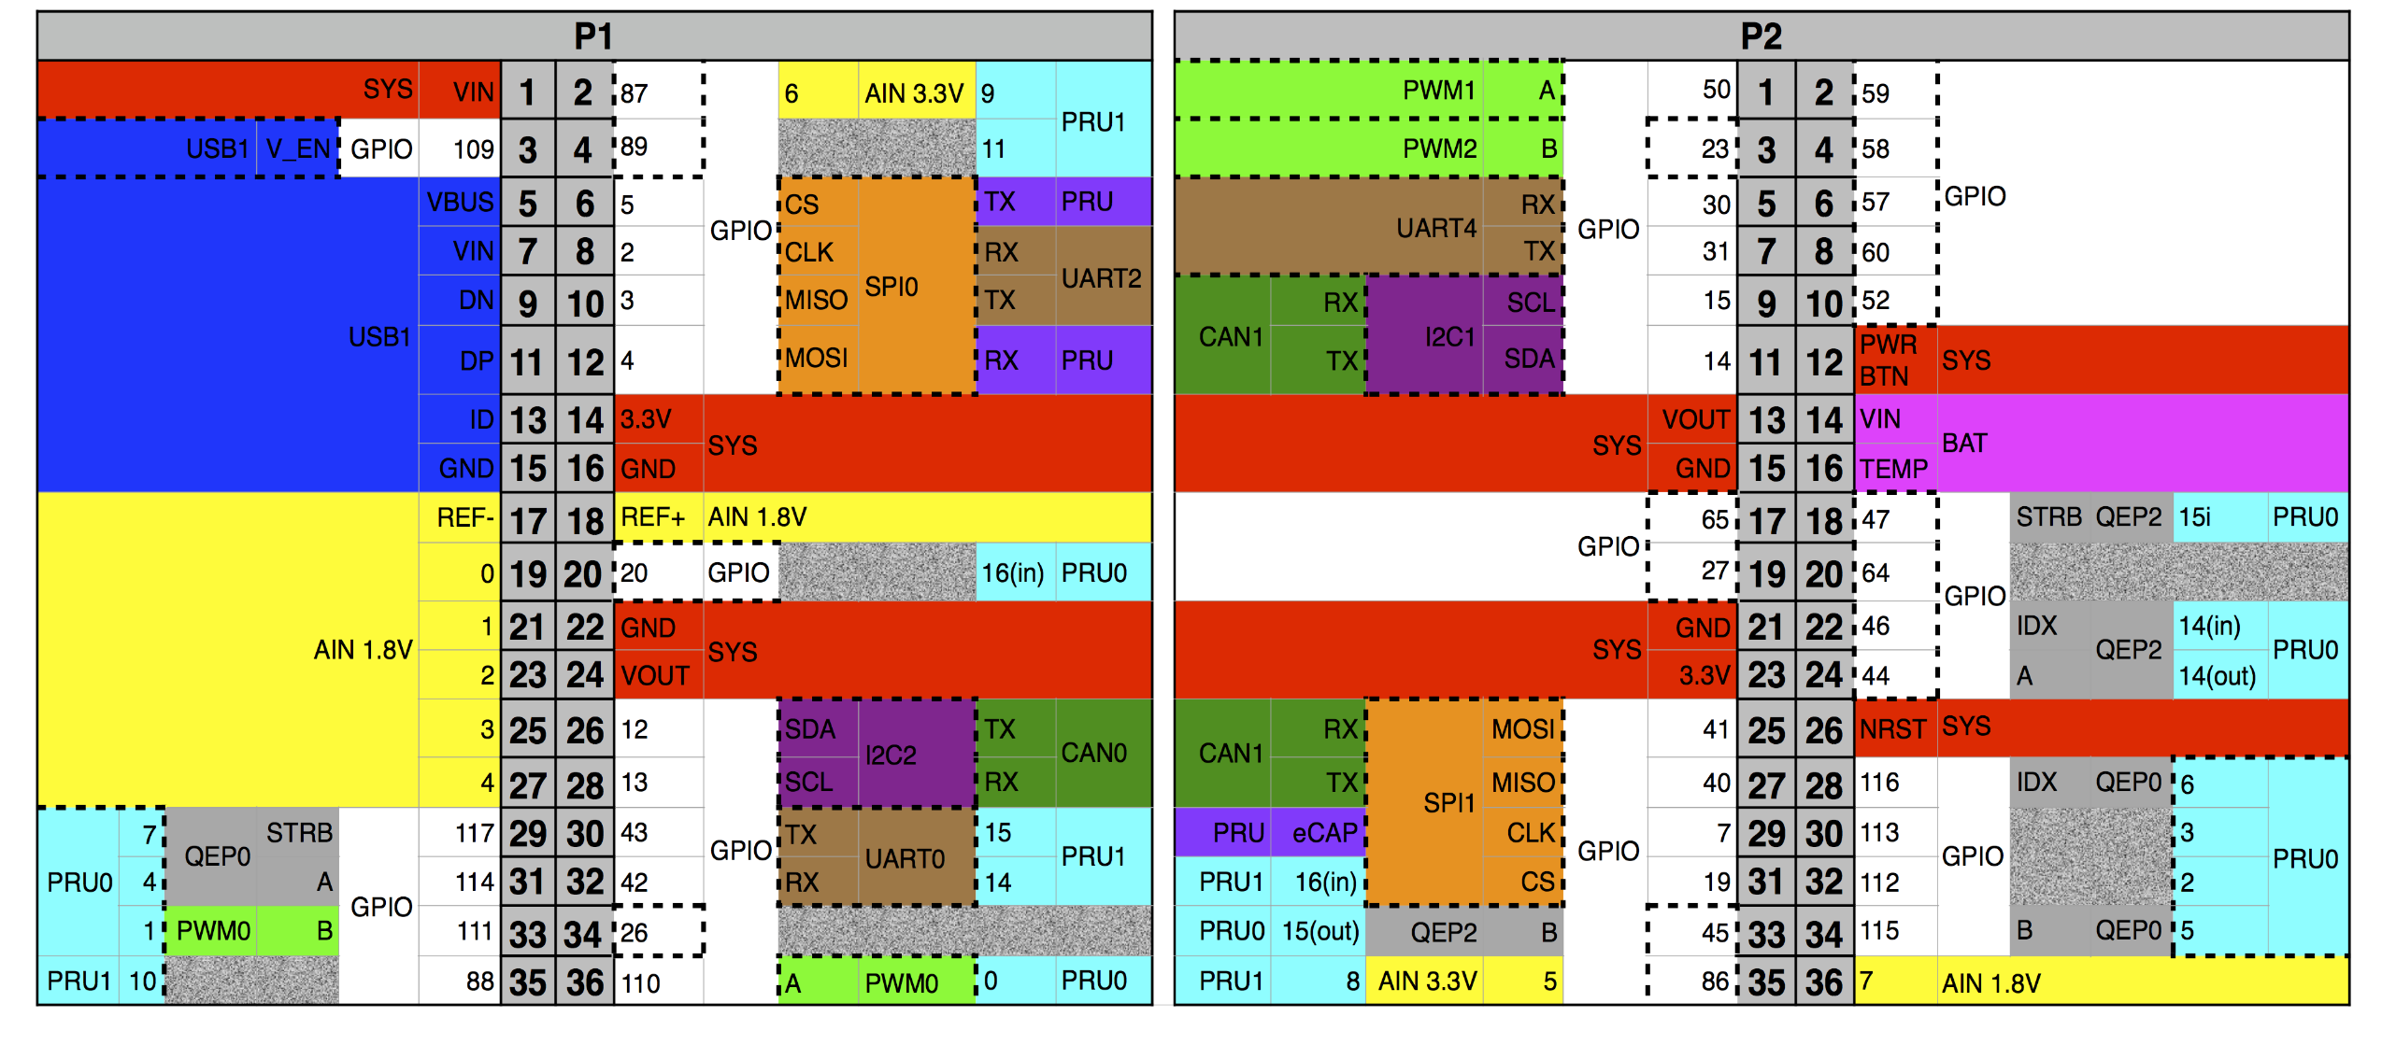
PocketBeagle® TechLab Cape Hands-On Coding Workshop
PocketBeagle®
PocketBeagle® is an ultra-tiny-yet-complete, low-cost, open-source USB-key-fob computer.
Processor System: Octavo Systems OSD3358-SM 21mm x 21mm system-in-package that includes 512MB DDR3 RAM, 1-GHz ARM Cortex-A8 CPU, 2x 200-MHz PRUs, ARM Cortex-M3, 3D accelerator, power/battery management and EEPROM
72 expansion pin headers with power and battery I/Os, high-speed USB, 8 analog inputs, 44 digital I/Os and numerous digital interface peripherals
microUSB host/client and microSD connectors
PocketBeagle Expansion Header Pin-out
Great getting started information is at beagleboard.org/pocket

Slide 4
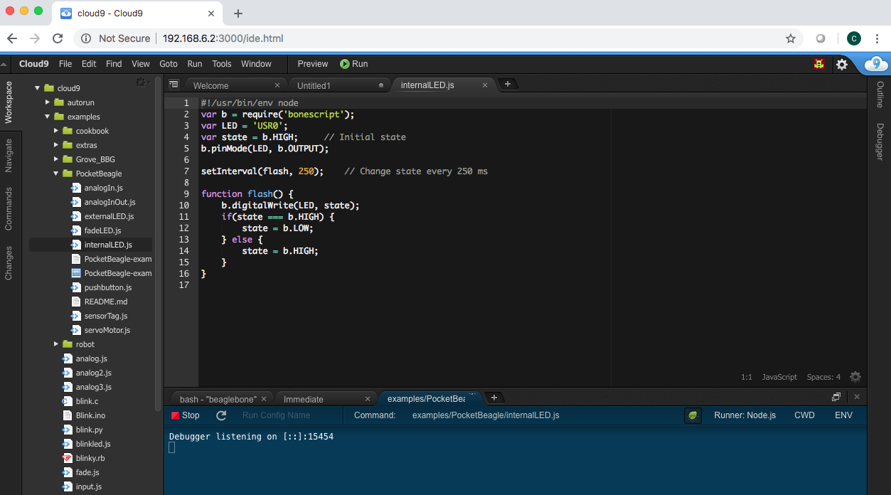
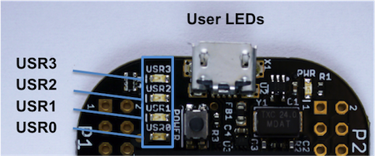
Blink PocketBeagle on-board USRx LED
Goal: Blink USR3 LED on PocketBeagle.
Overview: BoneScript is a Node.js library customized for the Beagle family and featuring familiar Arduino function calls. Here we will use it to blink an LED built into your PocketBeagle.
Do this in the Cloud9 IDE:
1. Navigate to TechLab/internalLED.js and double-click on it.
2. Click the Run button in the toolbar to execute the script in the active file window
3. You will see the run configuration window open with a Stop button. Click the Stop button to halt the program.
4. Try changing the LED or blink time, save the program and run again.
TIP: Click the green bug to disable the debugger and begin execution quicker.
2.
1.
Active File Window
Run Configuration Window
3.
internalLED.js
#!/usr/bin/env node
var b = require('bonescript');
var LED = 'USR3';
var state = b.HIGH; // Initial state
b.pinMode(LED, b.OUTPUT);
setInterval(flash, 250); // Change state every 250 ms
function flash() {
b.digitalWrite(LED, state);
if(state === b.HIGH) {
state = b.LOW;
} else {
state = b.HIGH;
}
}

Slide 5
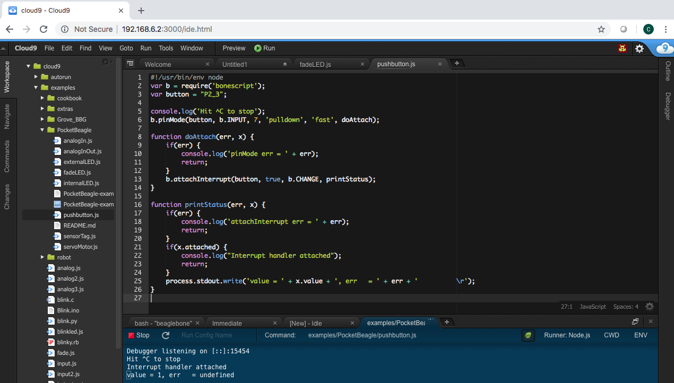
Read a button
Goal: Sense the external world by reading a digital input.
Overview: Reading a switch attached to a GPIO (general purpose input/output) port is as
easy as configuring the port as an input and attaching an interrupt handler to it. Note the buttons are “active low”.
Do this in the Cloud9 IDE:
1. Navigate to TechLab/pushbutton.js and double-click on it.
2. Click the Run button in the toolbar to execute the script in the active file window
3. Press the “L” button on TechLab and check the output (Value=1 or Value=0) in the configuration window. Click the Stop button on the IDE to halt the program.
Challenge #1: Can you modify the program to read from the “R” button?
Challenge #2: Can you modify the program to toggle the USR3 LED?
Challenge #3: Can you modify the program to turn the USR3 LED on with the “L” button and off with the “R” button?

Slide 6
Read a button
pushbutton.js
#!/usr/bin/env node
var b = require('bonescript');
var button = "P2_33";
console.log('Hit ^C to stop');
b.pinMode(button, b.INPUT, 7, null, null, doAttach);
function doAttach(err, x) {
if(err) {
console.log('pinMode err = ' + err);
return;
}
b.attachInterrupt(button, true, b.CHANGE, printStatus);
}
function printStatus(err, x) {
if(err) {
console.log('attachInterrupt err = ' + err);
return;
}
if(x.attached) {
console.log("Interrupt handler attached");
return;
}
process.stdout.write('value = ' + x.value + ' \r');
}

Slide 7
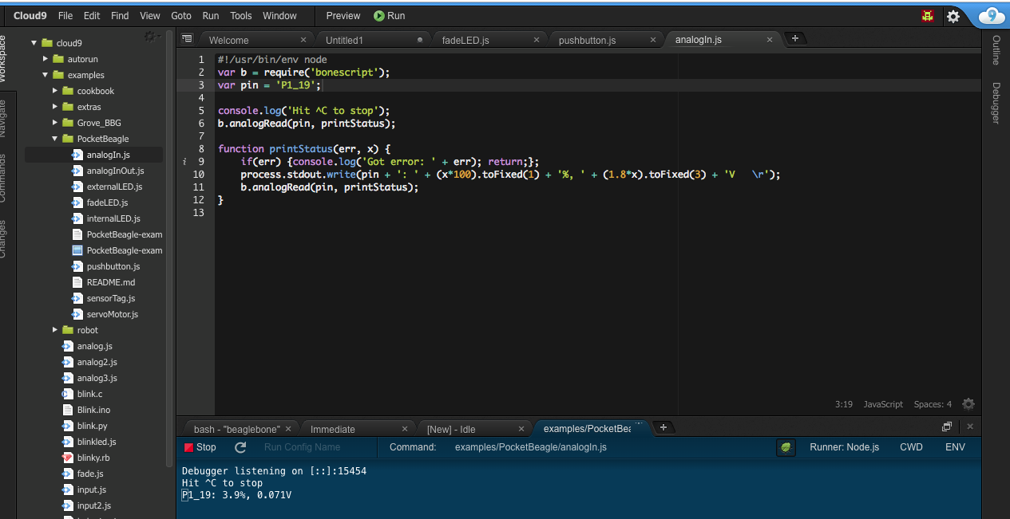
Read an analog sensor
Goal: Sense the external world by reading a variable analog input
Overview: Reading a light sensor attached to an analog input pin.
Do this in the Cloud9 IDE:
1. Navigate to TechLab/analogIn.js and double-click on it. 2. Click the Run button in the toolbar to execute the script in the active file window
3. Cover the light sensor and check the output in the configuration window. Click the Stop button to halt the program.
Challenge #1: Can you change how often the light sensor is read? What happens and why?
Challenge #2: Can you activate the USR3 LED based upon a voltage threshold from the light sensor?
Challenge #3: (Advanced Coding Lab) Try using the I2C accelerometer input from /sys/bus/iio/devices/iio:device1/in_accel_x_raw. Hint: use b.readTextFile()

Slide 8
Read an analog sensor
analogIn.js
#!/usr/bin/env node
var b = require('bonescript');
var pin = 'P1_19';
console.log('Hit ^C to stop');
doAnalogRead();
function printStatus(err, x) {
if(err) {console.log('Got error: ' + err); return;};
process.stdout.write(pin + ': ' + (x*100).toFixed(1) +
'%, ' + (1.8*x).toFixed(3) + 'V \r');
setTimeout(doAnalogRead, 100);
}
function doAnalogRead() {
b.analogRead(pin, printStatus);
}

Slide 9
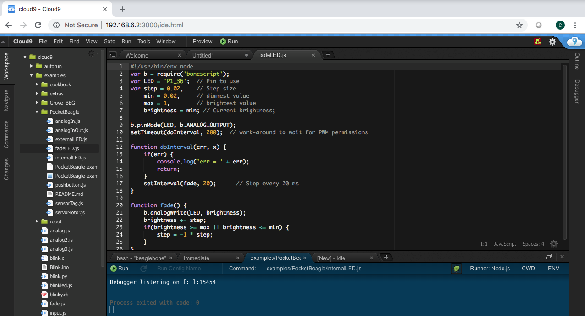
Fade an LED
Goal: Utilize a hardware pulse-width-modulator (PWM) to light an LED with variable brightness
Overview: Linux provides LED drivers that understand how to utilize PWM drivers, making use of PocketBeagle’s built-in PWM hardware. They are controlled with simple text files where you can set the brightness.
Do this in the Cloud9 IDE:
1. Navigate to TechLab/fadeLED.js and double-click on it.
2. Click the Run button in the toolbar to execute the script in the active file window
3. You will see the run configuration window open with a Stop button. Click the Stop button to halt the program.
Challenge #1: Try changing the fade interval, save the program and run again.
Challenge #2: Try using the light sensor input to set the LED brightness.
Challenge #3: (Advanced Coding Lab)
Try using the I2C accelerometer input for all 3 color LEDs..

Slide 10
Fade an LED
fadeLED.js
#!/usr/bin/env node
var b = require('bonescript');
var LED = '/sys/class/leds/techlab::blue/brightness';
var step = 10, // Step size
min = 0, // dimmest value
max = 255, // brightest value
brightness = min; // Current brightness;
doInterval();
function doInterval(err, x) {
if(err) {
console.log('err = ' + err);
return;
}
setInterval(fade, 20); // Step every 20 ms
}
function fade() {
b.writeTextFile(LED, brightness);
brightness += step;
if(brightness >= max || brightness <= min) {
step = -1 * step;
}
}

Slide 11
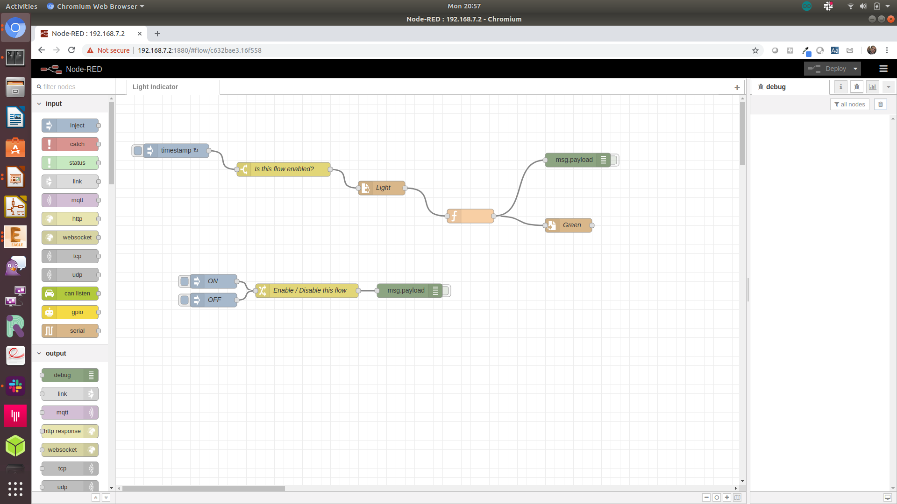
Using Node-RED to read and write files
Goal: Read light sensor data and output to green LED brightness
Overview: Node-RED is a flow-based development tool developed originally by IBM for wiring together hardware devices, APIs and online services as part of the Internet of Things. Node-RED provides a browser-based flow editor, which can be used to create JavaScript functions. Linux turns devices into virtual files, making Node-RED well suited to interacting with the physical world.
Do this:
1. Open Node-RED by pointing your browser to http://192.168.7.2:1880
2. Make sure the big “DEPLOY” button in the top right corner is greyed-out by clicking it. This makes sure any changes you’ve made have been started on your PocketBeagle. The program will run continuously.
3. Click the highlightable button to the left of the “ON”. Cover the light sensor to notice the brightness of the green LED adjust.
4. Try double-clicking on each node to see the parameters used for the demo.
5. Click the highlightable button to the left of the “OFF” to stop adjusting the brightness of the green LED.
6. Explore
Challenge #1: Try updating the blue LED rather than the green LED. Remember to click the “DEPLOY” button to save and run your changes.
Challenge #2: Try reading from the I2C accelerometer rather than the light sensor.
Challenge #3: Use a “gpio in” node to use the status of the “L” or “R” buttons to update the LED.

Slide 12
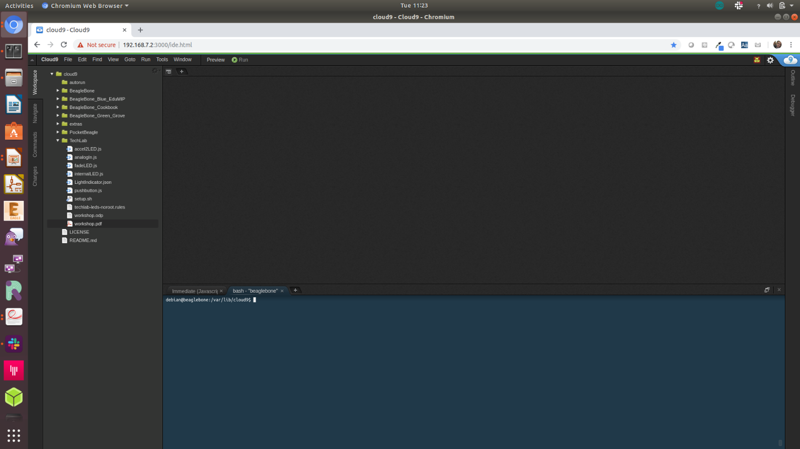
Explore the Linux command line
Goal: Learn to send several basic commands to the shell
Overview: The true power of Linux to automate many aspects of your life cannot be achieved without some utilization of the command line shell. The Cloud9 IDE makes it easy to access this directly from your web browser. Another great resource for learning is linuxcommand.org.
Do this in the Cloud9 IDE:
1. Click in the terminal window at the bottom half of the IDE. You can also open a new terminal by clicking the “+” in the window tabs and selecting “New Terminal”.
2. Try typing in the “commands to try”. Press <ENTER> after each command. Take note of how the prompt changes to show you the current active directory. Use the up and down arrows to cycle through commands you’ve typed before, in case you want to repeat any.
Challenge #1: Can you repeat the last command below that prints GPIO values and change the values?
Challenge #2: Using the “watch” command, can you monitor the I2C accelerometer status?
Challenge #3: Can you use the “config-pin” command to switch the red LED to a GPIO, set it high and low and then switch it back to PWM mode? What happens if the red LED is in GPIO mode and you change the brightness with the “/sys/class/leds” entry?
Some useful commands
pwd - show current directory
cd - change current directory
ls - list directory contents
chmod - change file permissions
chown - change file ownership
cp - copy files
mv - move files
rm - remove files
mkdir - make directory
rmdir - remove directory
cat - dump file contents
less - progressively dump file
vi - edit file (complex)
nano - edit file (simple)
head - trim dump to top
tail - trim dump to bottom
echo - print/dump value
env - dump environment variables
export - set environment variable
history - dump command history
grep - search dump for strings
man - get help on command
apropos - show list of man pages
find - search for files
tar - create/extract file archives
gzip - compress a file
gunzip - decompress a file
du - show disk usage
df - show disk free space
mount - mount disks
tee - write dump to file in parallel
hexdump - readable binary dumps
commands to try
cd /sys/class/leds
ls
echo 1 > techlab\:\:seg0/brightness
config-pin p1.33 pwm
echo 10 > techlab\:\:red/brightness
cd /sys/class/gpio
config-pin p1.29 gpio
cat gpio45/value gpio117/value

